Slide 1
- Getting started - Sale
Tryton By Example
Github - https://github.com/clixwise/tryton-by-example Version of presentation : 6.0 Version of Tryton : 6.0 Verified for execution on : Windows 10 & Powershell 7 Licence : CC BY 4.0 Author : Marc Rottiers

Slide 2
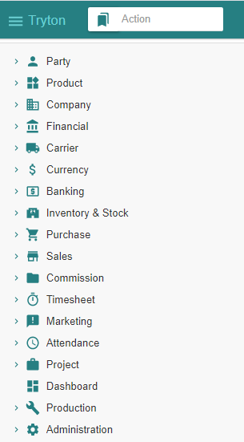
Table of Contents

Slide 3
TOC
MODULE ACTIVATION
Customer
Product
Inventory & Stock
Sale
STATE CHANGES
State Change - Impact Analysis Model
SALE PROCESS
Customer Sale
Customer Shipment
Customer Invoice
Customer Payment
Customer-related modules have been activated
Product-related modules have been activated
Stock-related modules have been activated
Activating Sale-related modules
The state diagram for “Sale” related operations
Recording a Sale
Recording a Shipment
Emitting an Invoice
Paying an Invoice

Slide 4
Chart of Accounts (Recap)

Slide 5
Chart of Account
We have installed the « French » chart of accounts : refer to « Basic Functionality » document.
We use the following accounts for the sale process
Balance Sheet Accounts
Income Statement Accounts
# | French | English
40 | Client | Customer
53 | Caisse | Cash
# | French | English
7x | Revenus | Revenue

Slide 6
Customer

Slide 7
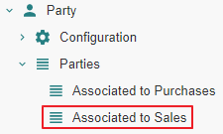
Motivation
Customers are named « Parties associated to Sales ». We name them hereafter « Customer » for commodity.
Customers are in fact party entity roles : any party promotes to a customer as soon as one or more sales are linked to it. Same for purchases.
Creation : a customer can be defined by creating an instance with the Menu Tree Item
« Parties » or
« Parties associated to Sales » if it exists (see Access hereafter).
Access : as long as no sale is linked to a party, it is not recognized as a customer and will only be accessible using the Menu Tree Item « Parties ».
Note finally that « Party » modules have been activated as explained in the previous document « Basic Functionality ».

Slide 8
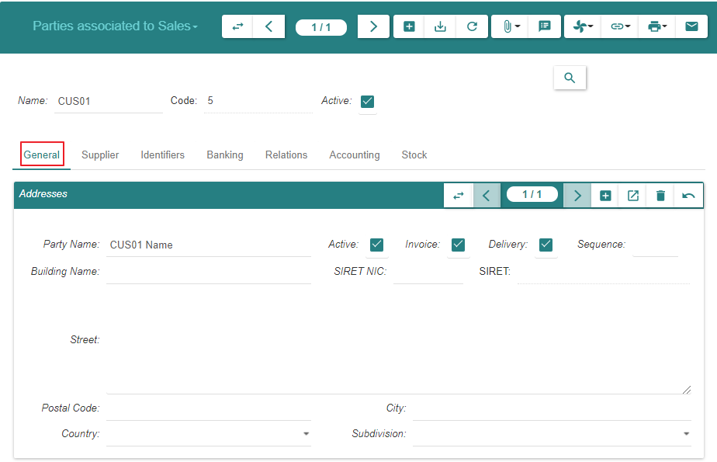
Create

Slide 9
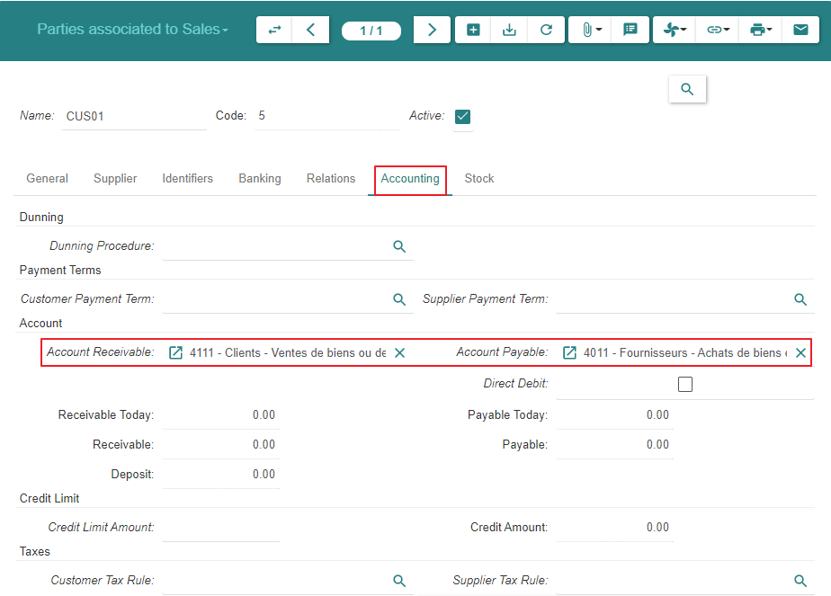
Create

Slide 10
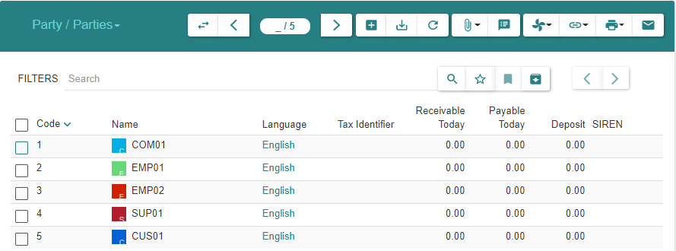
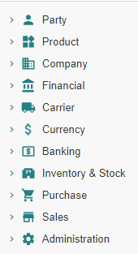
Summary
As explained under « Motivation », the customer always appears in the list « Parties » above
As long as there are no sales linked to the customer, it is absent from « Parties associated to Sales »
When at least one sale exists, the customer will appear in both lists : « Parties » and « Parties associated to Sales »

Slide 11
Product

Slide 12
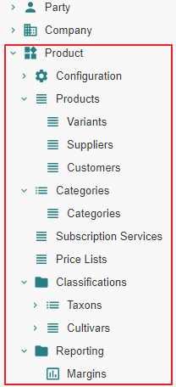
Motivation
Subject Area « Purchase » : « Product » related modules have been activated
Subject Area « Purchase » : a « Product » and its « Variant » have been defined

Slide 13
Inventory & Stock

Slide 14
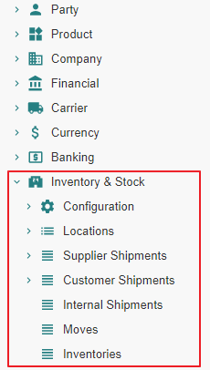
Motivation
Subject Area « Purchase » : « Inventory & Stock » related modules have been activated

Slide 15
Sale

Slide 16
Module Activation

Slide 17
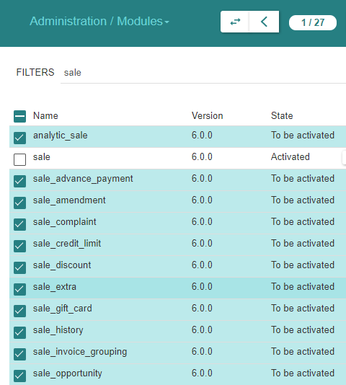
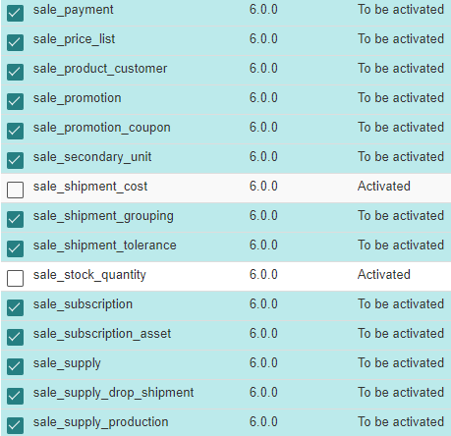
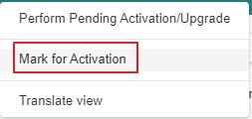
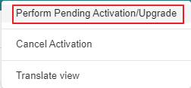
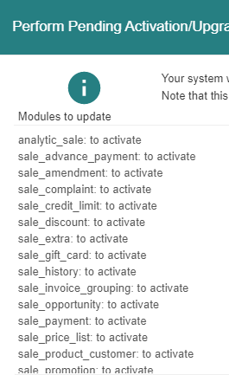
Module Activation

Slide 18
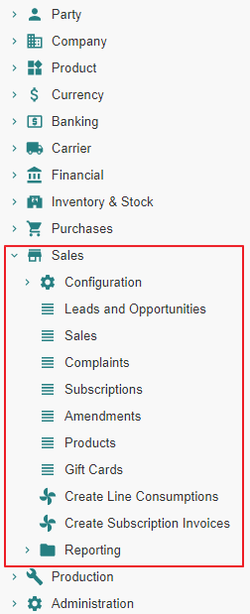
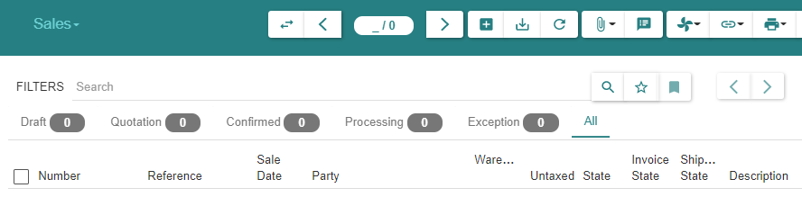
State « Post »

Slide 19
Sale Configuration

Slide 20
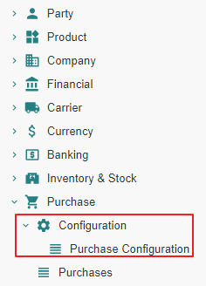
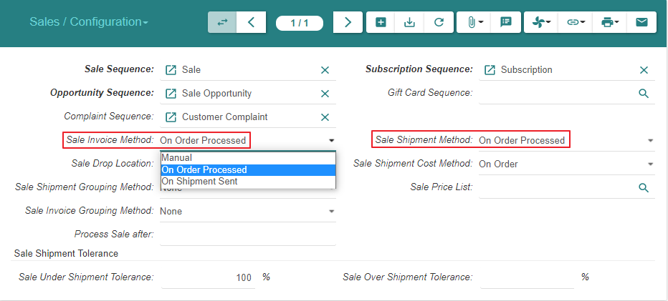
Sale Configuration (1/2)

Slide 21
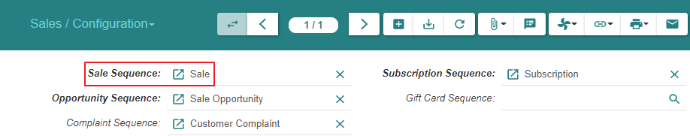
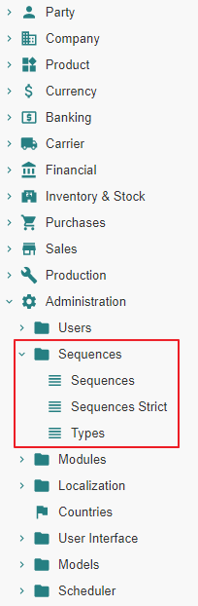
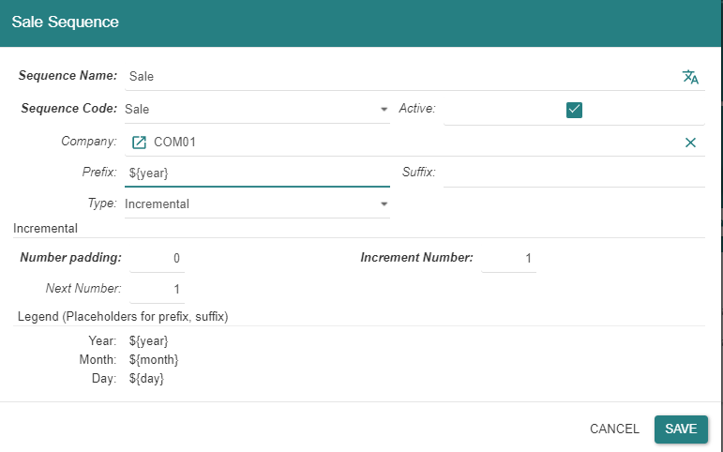
Sale Configuration (2/2)
Note : all sequences are also accessible thru Menu Tree Item « Administration / Sequences »

Slide 22
Sale - State Changes - Impact Analysis Model

Slide 23
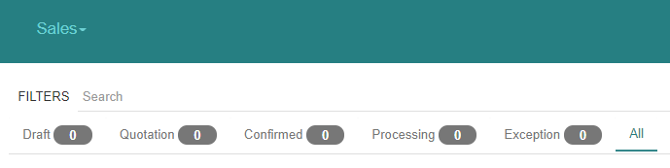
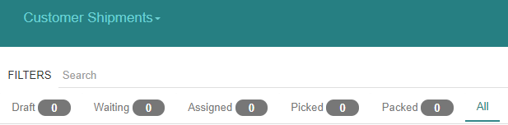
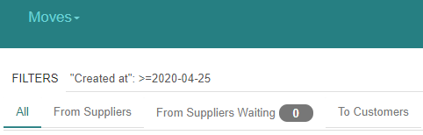
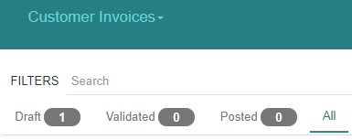
« Sales » related states

Slide 24
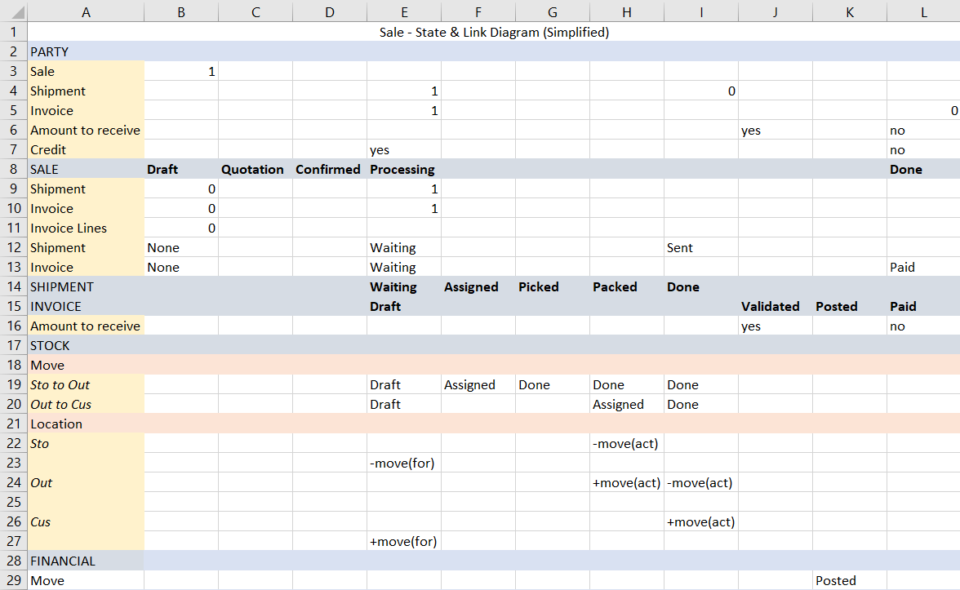

Slide 25
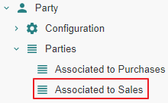
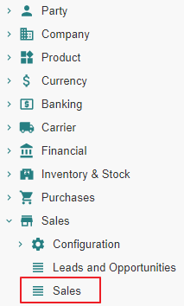
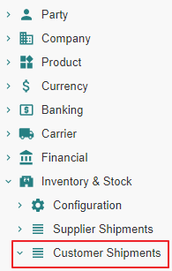
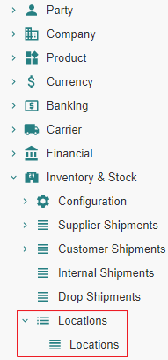
Impact analysis

Slide 26
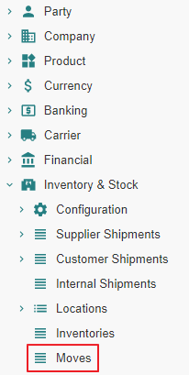
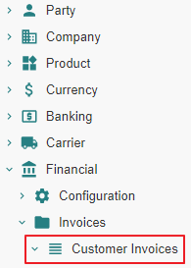
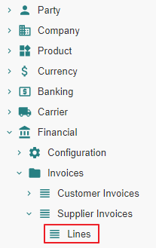
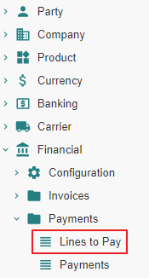
Impact analysis

Slide 27
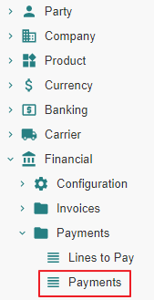
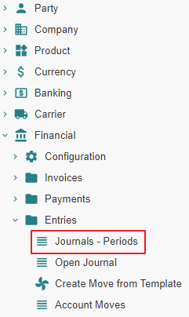
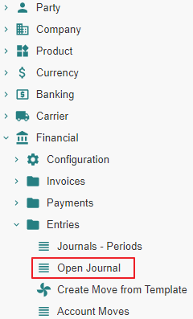
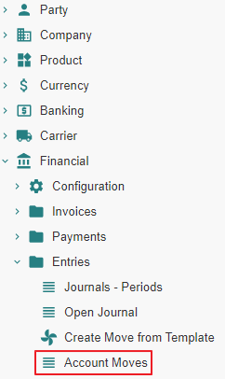
Impact analysis

Slide 28
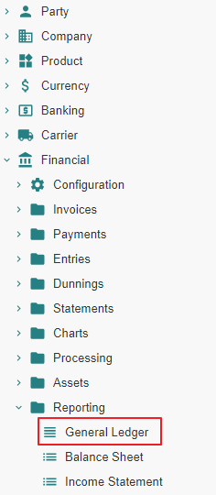
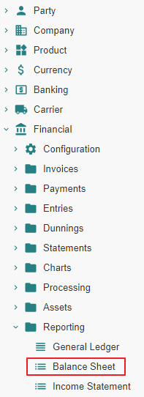
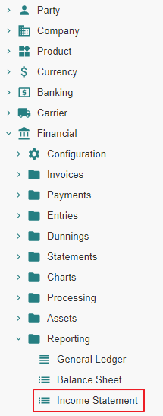
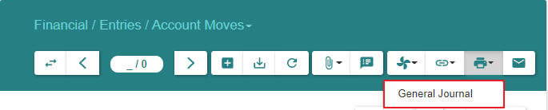
Impact analysis

Slide 29
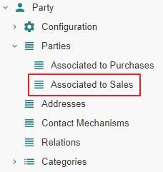
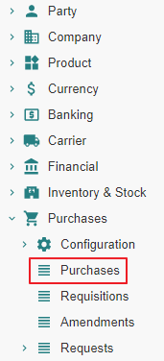
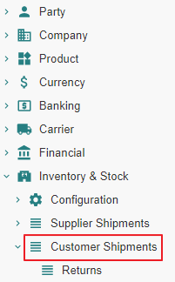
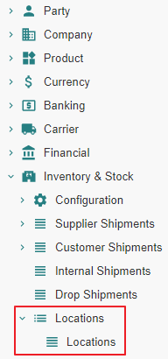
Impact analysis

Slide 30
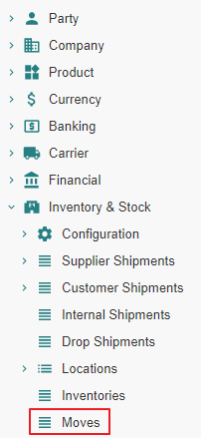
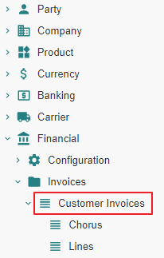
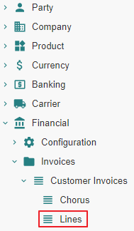
Impact analysis

Slide 31
Impact analysis

Slide 32
Impact analysis

Slide 33
Customer Sale - State Changes - Impact Analysis

Slide 34
Sale From State « Nill » to State « Draft »

Slide 35
Sale From State « Nill » to State « Draft » Action

Slide 36
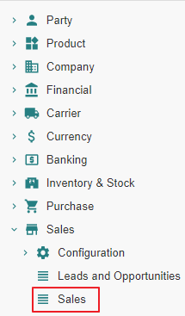
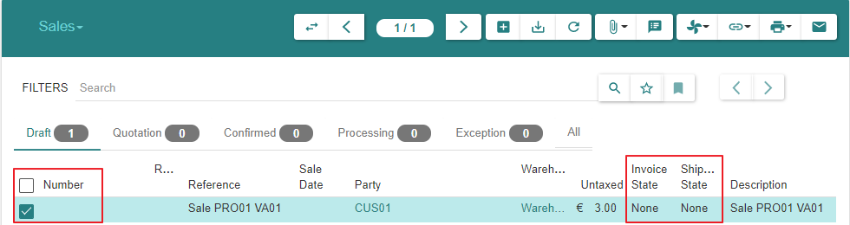

Sale
Sales are not numbered whilst they are in state « Draft »

Slide 37
Sale From State « Nill » to State « Draft » Impact

Slide 38


Slide 39


1 - Parties associated to Sales
We can navigate to « Sales », « Shipments » or « Invoices » from here on or from Menu Items

Slide 40


2 - Sales | Sales (SUP01)

Slide 41


8 - Lines to Pay

Slide 42

9 - Payments

Slide 43




10 - Journals - Periods

Slide 44


11 - Account Moves

Slide 45

11 - Account Moves

Slide 46


12 - Open Journal

Slide 47


12 - Open Journal

Slide 48


13 - General Ledger

Slide 49

14 - Balance Sheet

Slide 50

14 - Balance Sheet

Slide 51

16 - General Journal

Slide 52
Sale From State « Draft » to State « Quotation »

Slide 53
Sale From State « Draft » to State « Quotation » Action

Slide 54


Sale
Sales are numbered when they reach state « Quotation »
Sales can be returned to state « Draft », e.g. when the price has been renegociated with the « Customer »

Slide 55
Sale From State « Draft » to State « Quotation » Impact

Slide 56


Slide 57


1 - Parties associated to Sales
We can navigate to « Sales », « Shipments » or « Invoices » from here on or from Menu Items

Slide 58


2 - Sales | Sales (CUS01)

Slide 59
Sale From State « Quotation » to State « Confirmed » or From State « Quotation » to State « Processing »

Slide 60
Sale From State « Quotation » to State «Processing »

Slide 61
Sale From State « Quotation » to State «Processing » Action

Slide 62
State transitions
Upon « Confirm » action by the user, a « Sale » or « Purchase » evolves from state « Quotation » to :
State « Confirmed » when a latent sale processing error condition exists
State « Processing » when such error does not exist.
- In the present scenario, there is no error condition and the state transition is from « Quotation » to « Processing »
Confirmed
Confirm
-
Sale Processing related Error Condition Exists
Confirm
-
Sale Processing related Error Condition Resolved
Confirm
-
Sale Processing possible
Confirm
Quotation
Processing

Slide 63


Sale

Slide 64

Sale

Slide 65
Sale From State « Quotation » to State «Processing » Impact

Slide 66


Slide 67

1 - Parties associated to Sales

Slide 68


2 - Sales | Sales (CUS01)

Slide 69


3 - Customer Shipments | Customer Shipments (CUS01)
The « Customer Shipment » is created in state « Waiting », not « Draft »
Althoug the « Customer Shipment » can be reverted subsequently to state « Draft », it should be noted that its property « Reference » cannot be edited anymore

Slide 70


3 - Customer Shipments | Customer Shipments (CUS01)

Slide 71


4 - Stock Locations

Slide 72



4 - Stock Locations : Storage Zone - Output Zone - Customer

Slide 73

5 - Stock Moves

Slide 74

5 - Stock Moves

Slide 75

5 - Stock Moves

Slide 76



6 - Invoices | Invoices (CUS01)

Slide 77

6 - Invoices | Invoices (CUS01)

Slide 78

7 - Invoice Lines

Slide 79
Customer Shipment - State Changes - Actual States

Slide 80
Motivation
It is certainly possible to process the shipment(s) pertaining to a « Sale » using the « Move » menu item.
However, it is recommended to proceed using the « Customer Shipment » functionality which will manage the following stock moves in a coherent fashion :
« Storage Moves » between the warehouse storage location and the warehouse output location
« Outgoing Moves » between the warehouse output location and the customer location

Slide 81
Customer Shipment « Nill » To « Draft »

Slide 82
Creation
The « Customer Shipment » is initially created in state « Waiting », not « Draft »
This occurs when the « Sale » evolves into state « Processing »
Hence, we do not document the inexisting state « Draft »

Slide 83
Customer Shipment « Nill » To « Waiting »

Slide 84
Creation
The « Customer Shipment » is created in state « Waiting »
This occurs when « Sale » evolves into state « Processing »

Slide 85
Customer Shipment « Waiting » To « Assigned »

Slide 86
Customer Shipment From « Waiting » To « Assigned » Action

Slide 87

Customer Shipments - Inventory Moves

Slide 88

Customer Shipments - Outgoing Moves

Slide 89
Customer Shipment From « Waiting » To « Assigned » Impact

Slide 90


Slide 91


2 - Sales | Sales (CUS01)

Slide 92



3 - Customer Shipments | Customer Shipments (CUS01)

Slide 93


5 - Stock Moves

Slide 94
Customer Shipment From « Assigned » to « Picked »

Slide 95
Customer Shipment From « Assigned » to « Picked » Action

Slide 96

Customer Shipments - Inventory Moves

Slide 97

Customer Shipments - Outgoing Moves

Slide 98
Customer Shipment From « Assigned » to « Picked » Impact

Slide 99


Slide 100



3 - Customer Shipments | Customer Shipments (CUS01)

Slide 101

5 - Stock Moves

Slide 102
Customer Shipment From « Picked » to « Packed »

Slide 103
Customer Shipment From « Picked » to « Packed » Action

Slide 104


Customer Shipments - Inventory Moves

Slide 105

Customer Shipments - Outgoing Moves

Slide 106
Customer Shipment From « Picked » to « Packed » Impact

Slide 107


Slide 108



3 - Customer Shipments | Customer Shipments (CUS01)

Slide 109

3 - Customer Shipments | Customer Shipments (CUS01)

Slide 110
4 - Stock Locations : Storage Zone - Output Zone - Customer

Slide 111



4 - Stock Locations : Storage Zone - Output Zone - Customer

Slide 112

5 - Stock Moves

Slide 113
Customer Shipment From « Packed » to « Done »

Slide 114
Customer Shipment From « Packed » to « Done » Action

Slide 115

Customer Shipments - Inventory Moves

Slide 116

Customer Shipments - Outgoing Moves

Slide 117
Customer Shipment From « Packed » to « Done » Impact

Slide 118


Slide 119

1 - Parties associated to Sales

Slide 120


2 - Sales | Sales (CUS01)

Slide 121



3 - Customer Shipments | Customer Shipments (CUS01)

Slide 122
4 - Stock Locations

Slide 123



4 - Stock Locations : Storage Zone - Output Zone - Customer

Slide 124

5 - Stock Moves

Slide 125
Customer Invoice - State Changes - Actual States

Slide 126
Customer Invoice « Nill » To « Draft »

Slide 127
Creation
The « Customer Invoice » is initially created in state « Draft »
The system creates such invoice when the « Sale » evolves into state « Processing »

Slide 128


Invoice

Slide 129
Customer Invoice « Draft » To « Validated »

Slide 130
Customer Invoice From « Draft » To « Validated » Action

Slide 131

Customer Invoices (1/2)

Slide 132

Customer Invoices (2/2)

Slide 133
Customer Invoice From « Draft » To « Validated » Impact

Slide 134


Slide 135

1 - Parties associated to Sales

Slide 136


2 - Sales | Sales (CUS01)

Slide 137
6 - Invoices | Invoices (CUS01) (1/2)

Slide 138
6 - Invoices | Invoices (CUS01) (2/2)

Slide 139



10 - Journals - Periods

Slide 140

11 - Account Moves

Slide 141

12 - Open Journal

Slide 142
13 - General Ledger

Slide 143
14 - Balance Sheet

Slide 144
14 - Balance Sheet

Slide 145
16 - General Journal

Slide 146
Customer Invoices From State « Validated » to State « Posted »

Slide 147

Motivation
https://www.accountingtools.com/articles/what-is-posting-in-accounting.html

Slide 148
Customer Invoices From State « Validated » to State « Posted » Action

Slide 149


Customer Invoices (1/2)

Slide 150

Customer Invoices (2/2)

Slide 151
Customer Invoices From State « Validated » to State « Posted » Impact

Slide 152


Slide 153


1 - Parties associated to Sales

Slide 154


2 - Sales | Sales (CUS01)

Slide 155
6 - Customer Invoices (1/2)

Slide 156
6 - Customer Invoices (2/2)

Slide 157

8 - Lines to Pay

Slide 158
9 - Payments

Slide 159



10 - Journals - Periods

Slide 160

11 - Account Moves

Slide 161

11 - Account Moves

Slide 162

11 - Account Moves

Slide 163




12 - Open Journal

Slide 164

13 - General Ledger

Slide 165

14 - Balance Sheet

Slide 166

14 - Balance Sheet

Slide 167

15 - Income Statement

Slide 168

16 - General Journal

Slide 169
Customer Payment - State Changes - Actual States

Slide 170
Payment

Slide 171
Payment Precondition

Slide 172




Invoice Payment Method

Slide 173
Payment Action

Slide 174



Customer Invoices (1/2)

Slide 175

Customer Invoices (2/2)

Slide 176
Payment Impact

Slide 177


Slide 178


1 - Parties associated to Sales

Slide 179

1 - Parties associated to Sales

Slide 180


2 - Sales | Sales (CUS01)

Slide 181
6 - Customer Invoices (1/2)

Slide 182
6 - Customer Invoices (2/2)

Slide 183

10 - Journals - Periods

Slide 184

11 - Account Moves

Slide 185
11 - Account Moves

Slide 186

11 - Account Moves

Slide 187

12 - Open Journal

Slide 188
13 - General Ledger

Slide 189

14 - Balance Sheet

Slide 190

14 - Balance Sheet

Slide 191

16 - General Journal

